Slide 1




School of Computer and System Sciences
SMART
APPOINTMENT BOOKING SYSTEM
An Automated and Scalable Web-Based Solution for Efficient Scheduling
Faculty:
Poonguzhali N

Slide 2






Problem Statement
Traditional appointment booking systems rely heavily on manual processes like phone calls or in-person visits, where calls may go unanswered, appointments may not be recorded properly, and availability is unclear. This creates inconvenience for users, delays in scheduling, and highlights the need for a reliable, digital system that ensures accurate, real-time appointment management.

Slide 3

Introduction
The Smart Appointment Booking System solves this problem by allowing users to book appointments online easily. Users can check available time slots and book instantly, while service providers can manage their schedules properly. This system makes the process faster, more reliable, and convenient for everyone.

Slide 4


Objectives
1. To design an online system for appointment scheduling.
2. To reduce manual work involved in managing appointments.
3. To implement service oriented architecture in a web application.
4. To provide a user friendly interface for users and providers.
5. To improve efficiency and reduce appointment conflicts.

Slide 5
System Architecture
Presentation Layer
Application Layer
Data Layer
React.js (User Interface)
Used by:
- Users (book appointments)
- Service Providers
(manage schedules)
Sends requests to backend
through API
API Gateway (main entry point)
Authentication Service → Login & security
Provider Service → Manage doctors/services
Booking Service → Appointment scheduling
Payment Service → Payment handling
Notification Service → Alerts & reminders
MongoDB
Stores:
User data
Provider details
Appointment records
Payment information

Slide 6
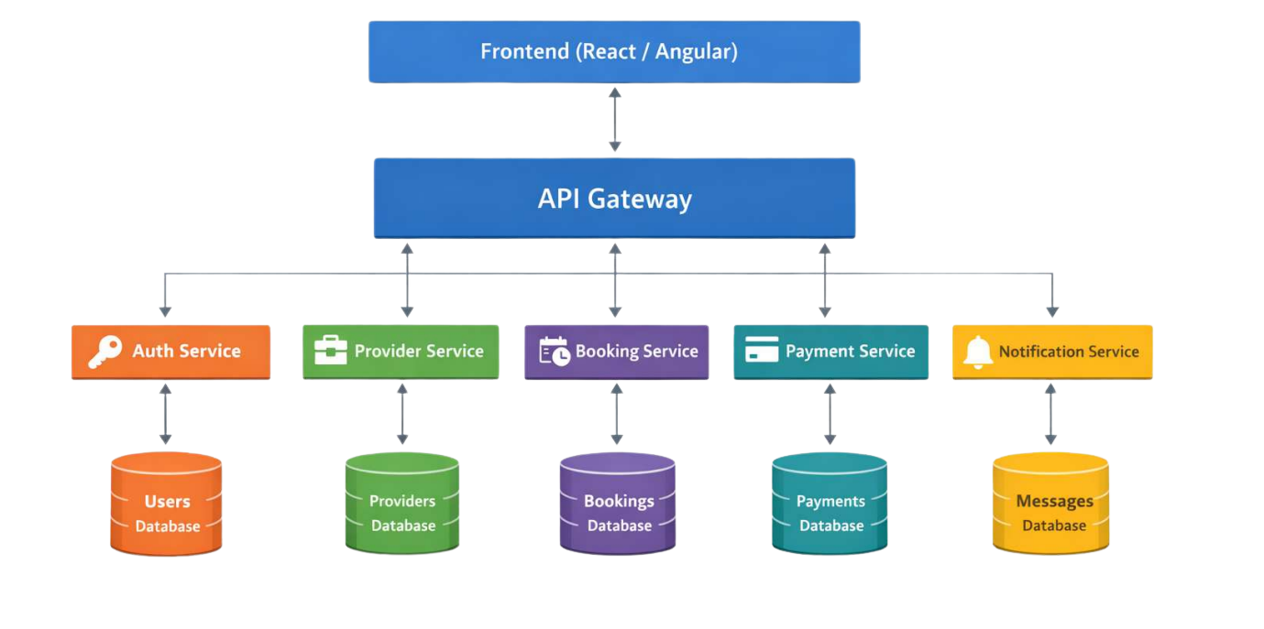
System Architecture

Slide 7

Tech Stack
FrontEnd
BackEnd
React.js
HTML
CSS
JavaScript
Node.js
Express.js
MongoDb
REST API

Slide 8


Module-wise Services
User Module Services -
registration, login, booking appointments.
Provider Module Services -
manage provider details and availability.
Booking Module Services -
handles scheduling and appointment records.
User Module Services -
processes payments.
User Module Services -
sends reminders and confirmations.

Slide 9

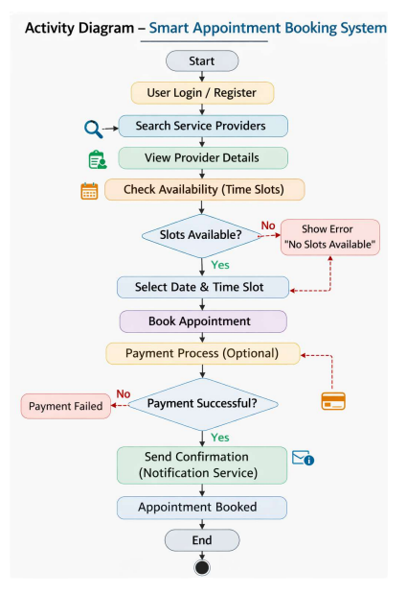
Activity Diagram

Slide 10

Conclusion
In conclusion, the Smart Appointment Booking System makes the process of booking appointments much easier and more reliable compared to traditional methods. Overall, it saves time, reduces confusion, and provides a better experience for everyone.
Future improvements may include mobile applications, AI based recommendations, integration with Google Calendar, push notifications, and advanced analytics dashboards.

Slide 11



THANK
YOU

